Slide 1
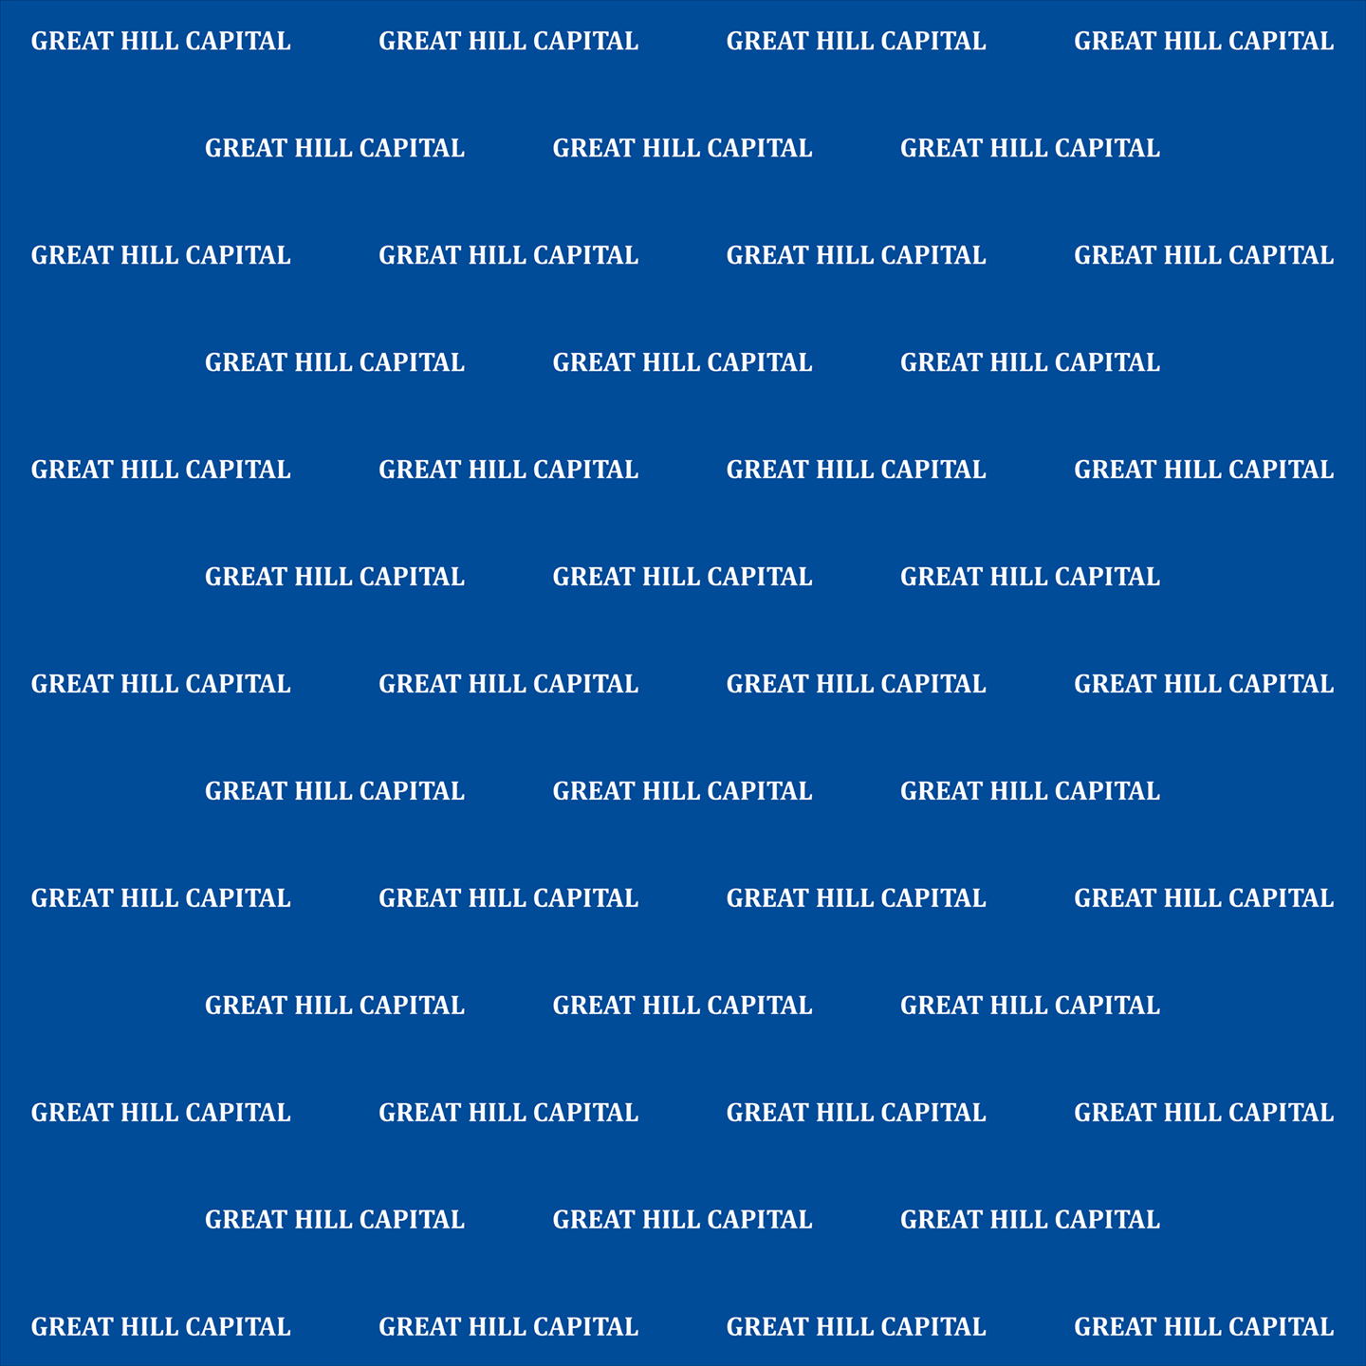
Outperformance
Themes for 2024

Slide 2
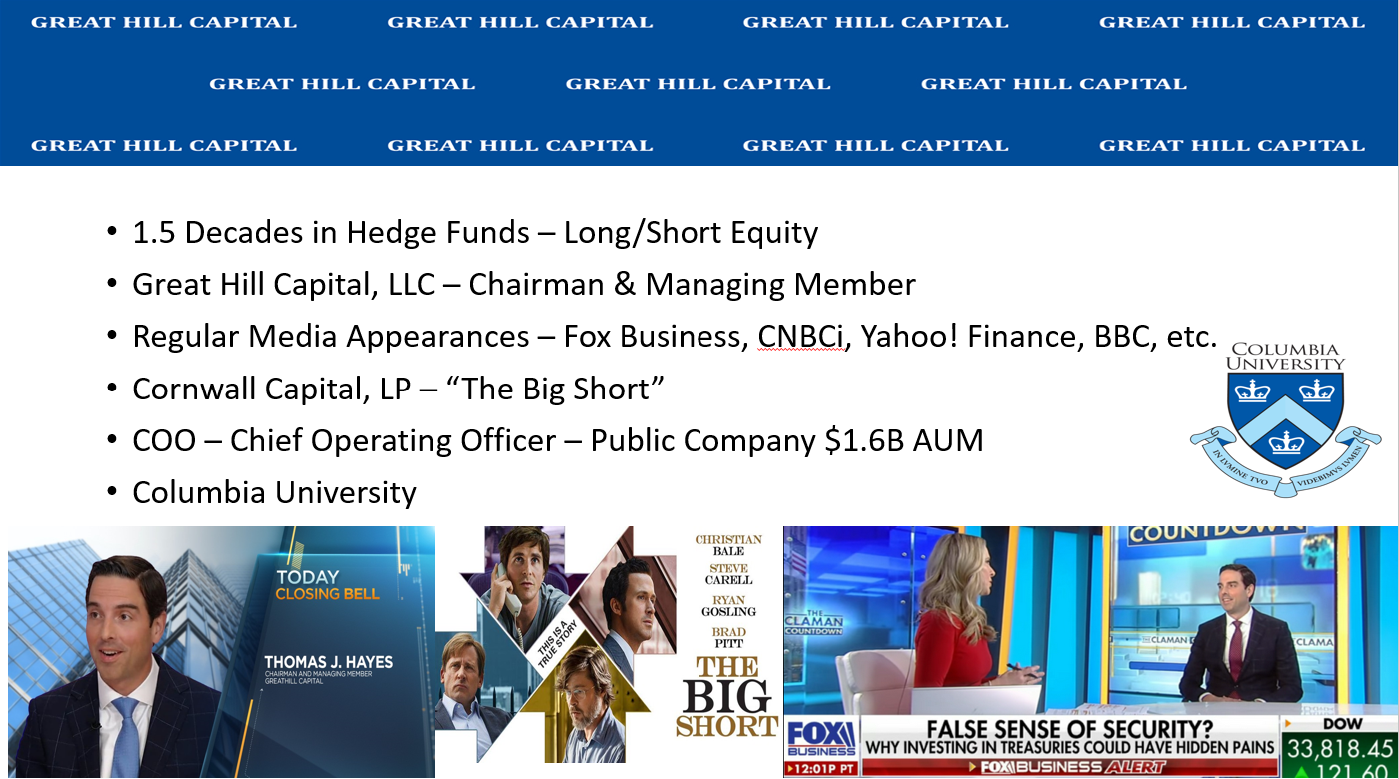

Slide 3
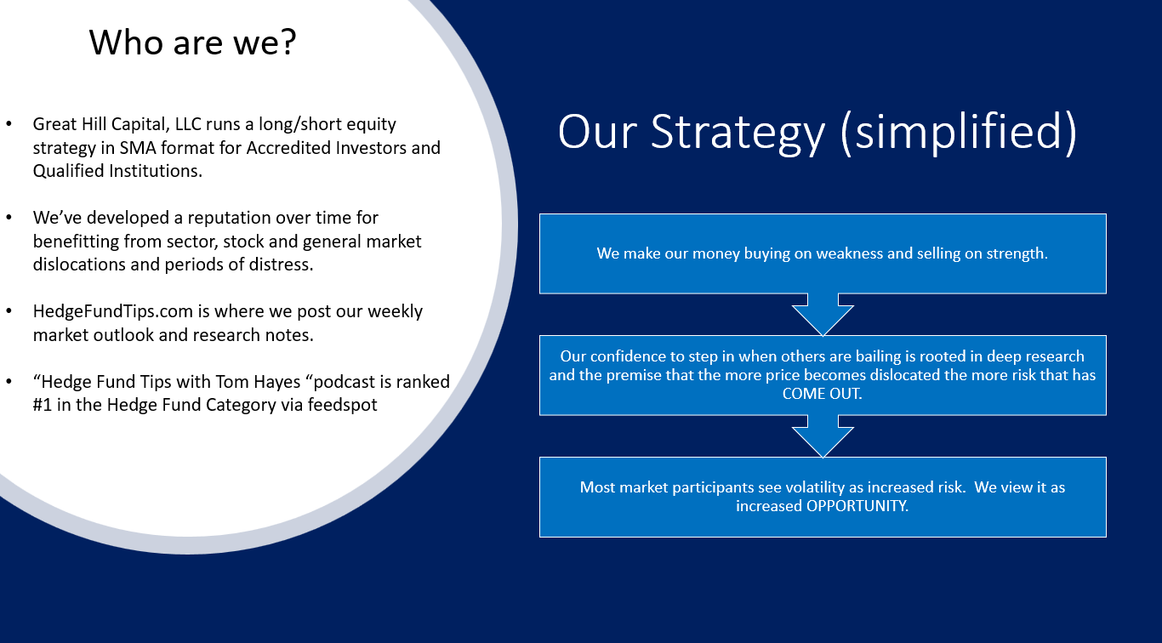

Slide 4

Our Investment Philosophy in a Nutshell:

Slide 5
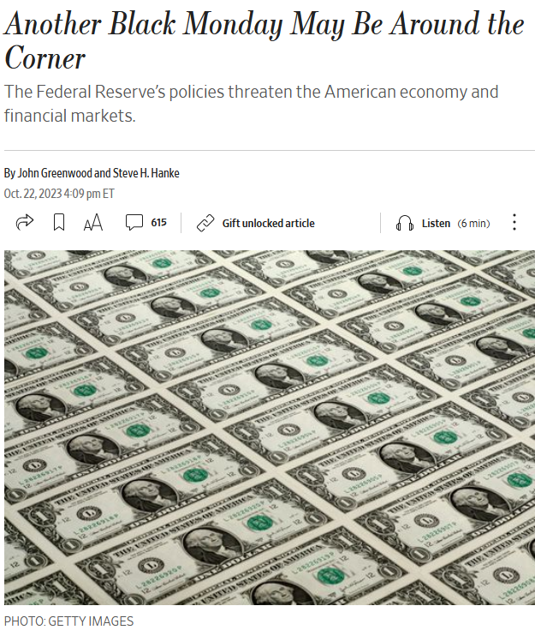
Market Doom and Gloom Warranted?

Slide 6
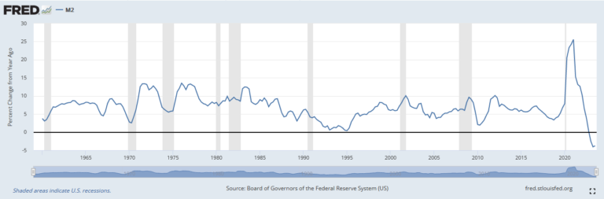
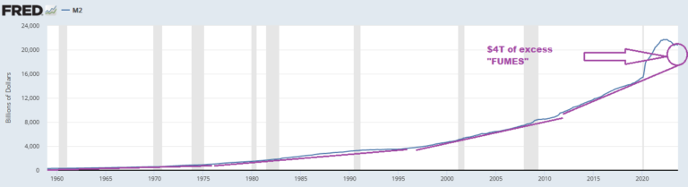
Money Supply Contraction Fears Overblown

Slide 7
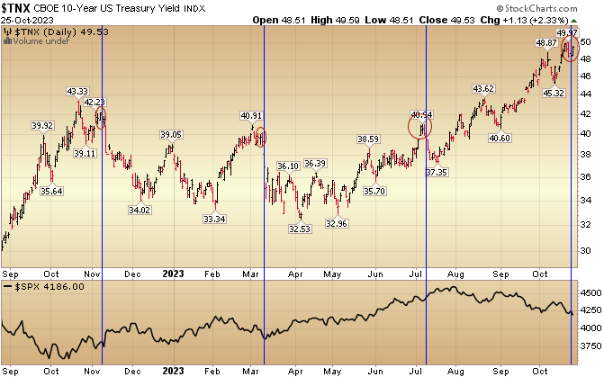
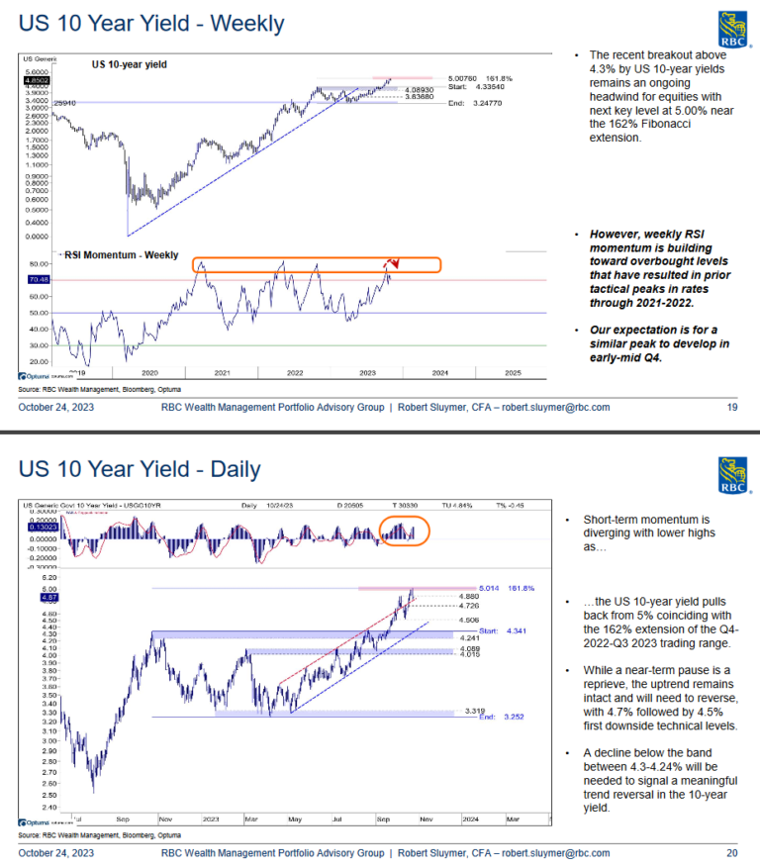
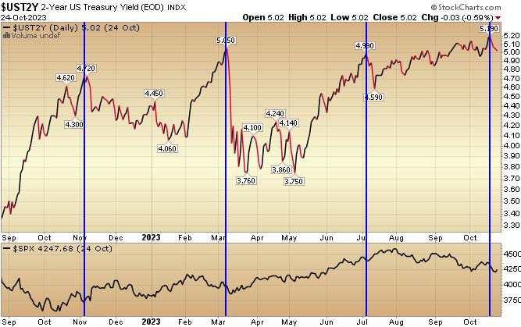
Yields Need To Hold ~5% or Below…

Slide 8
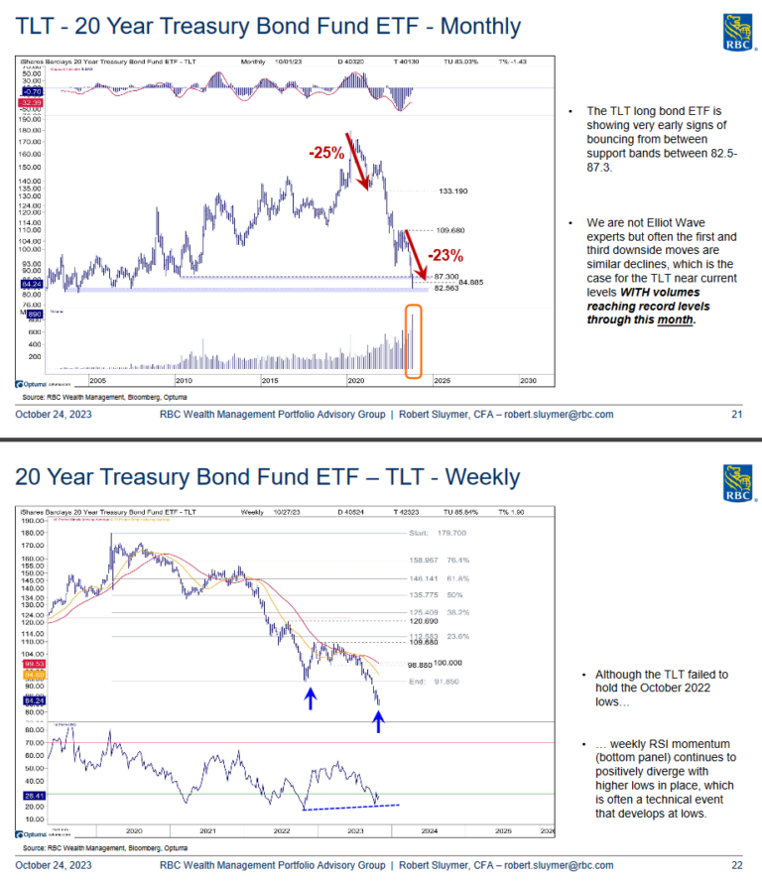
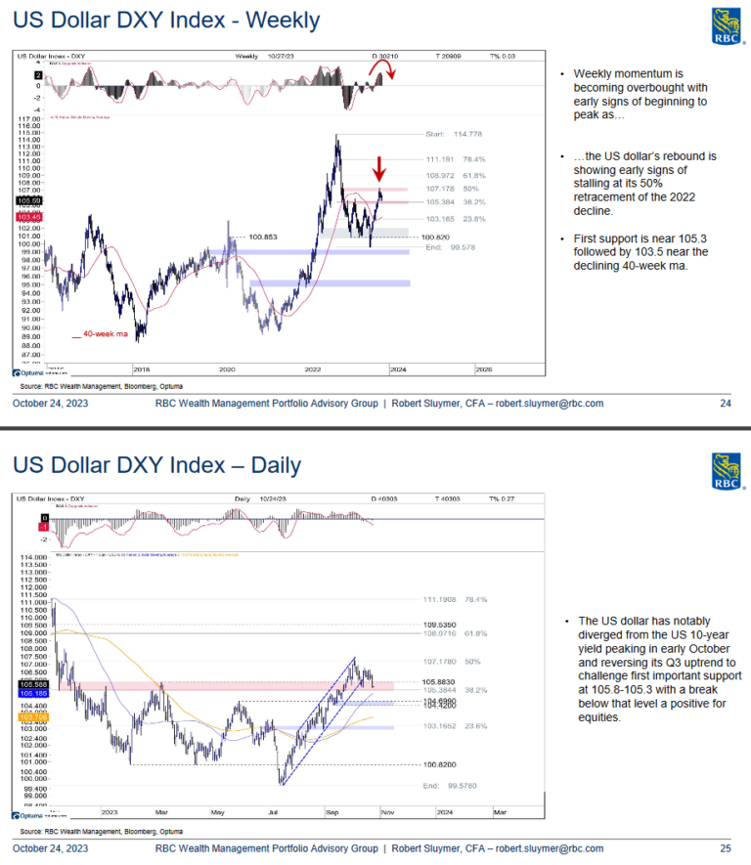
Yields Hold, USD Weakens…

Slide 9
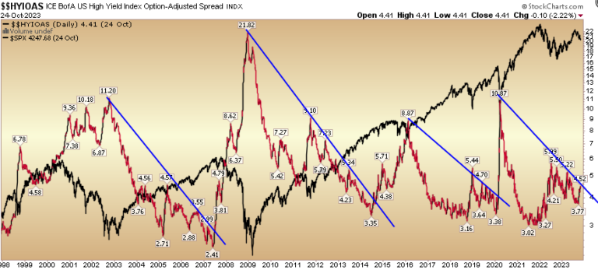
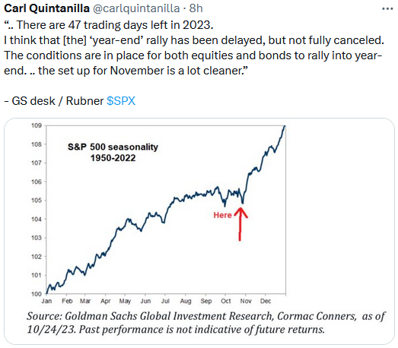
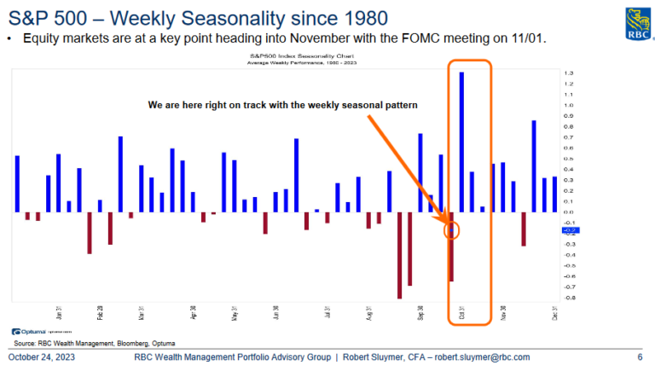
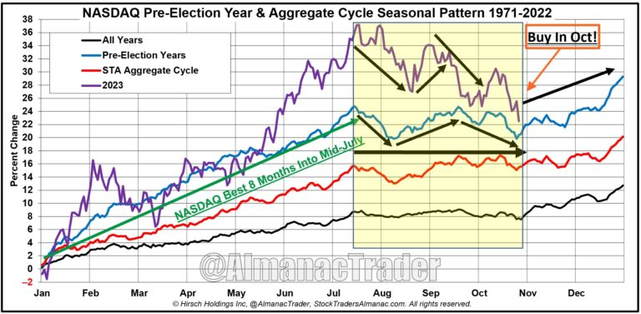
Credit Spreads Okay. Seasonality Kicks In…

Slide 10
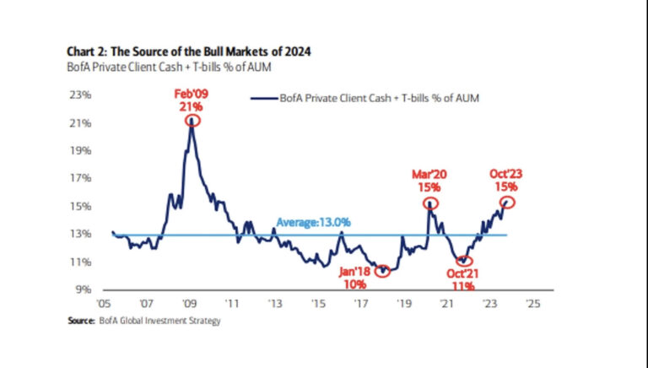
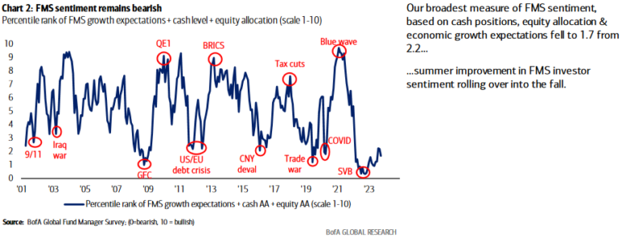
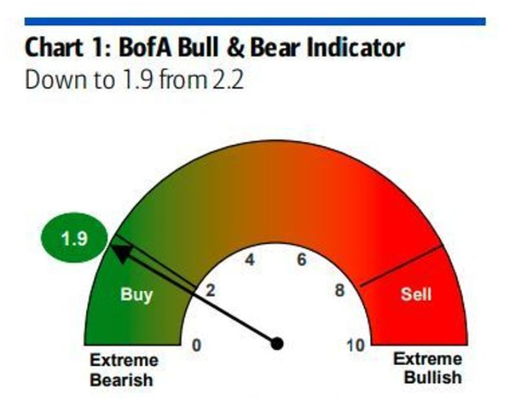
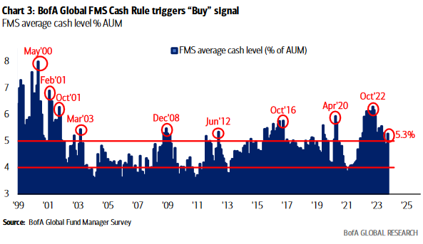
Positioning Excessively Bearish/Crowded…

Slide 11
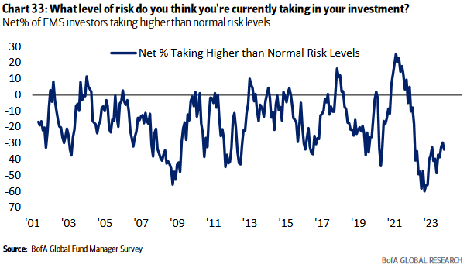
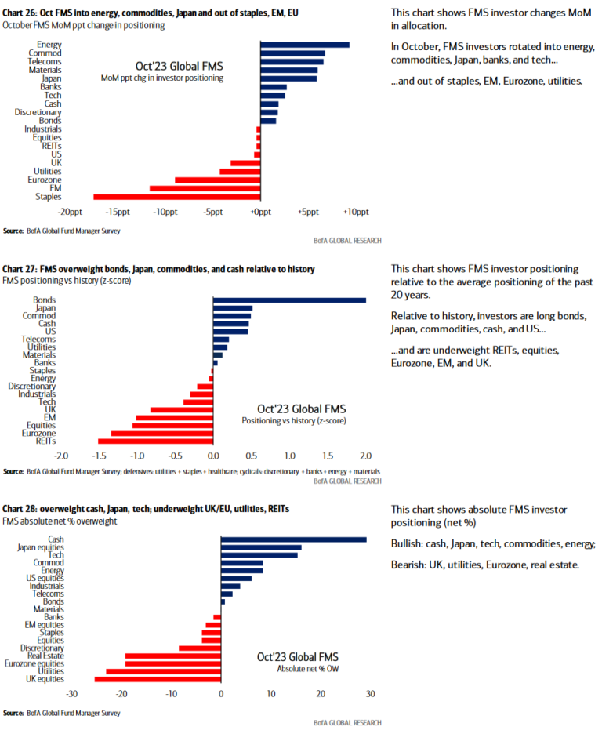
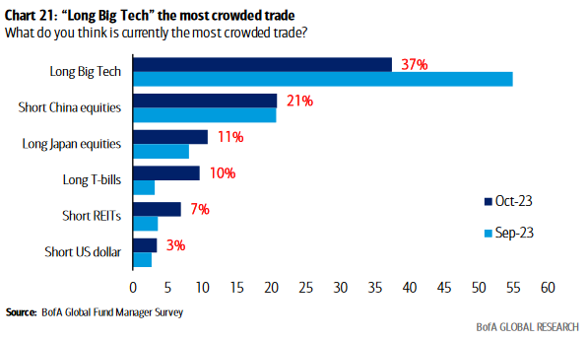
More on consensus crowding…

Slide 12
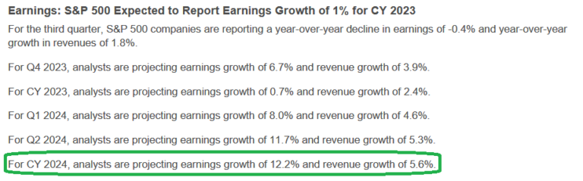
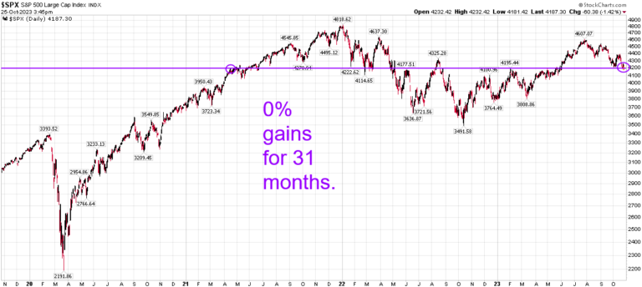
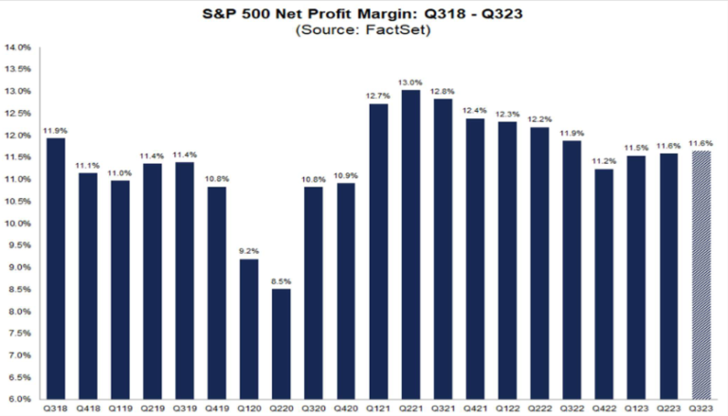
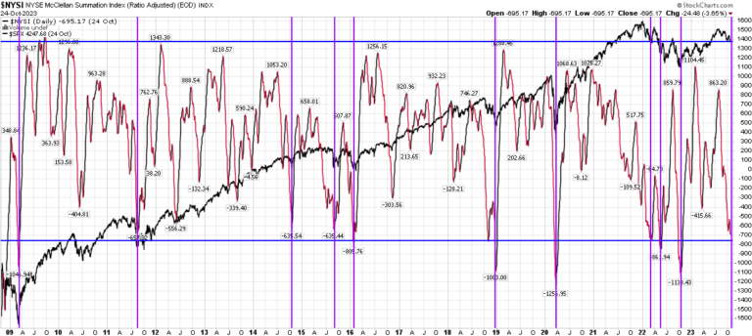
Earnings/Extremes

Slide 13
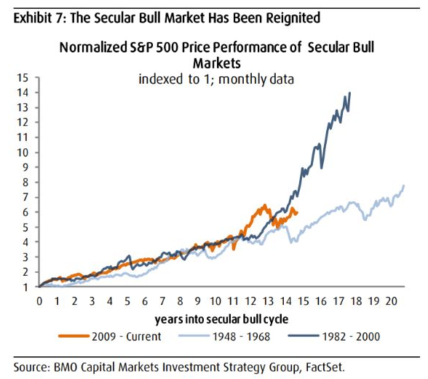
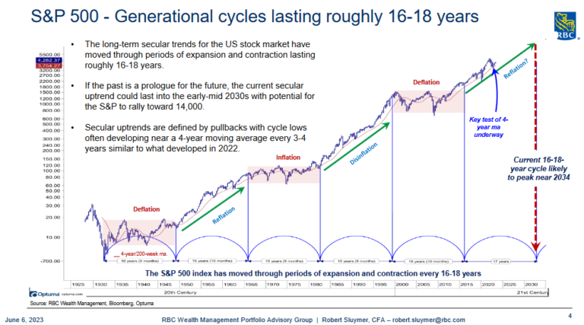
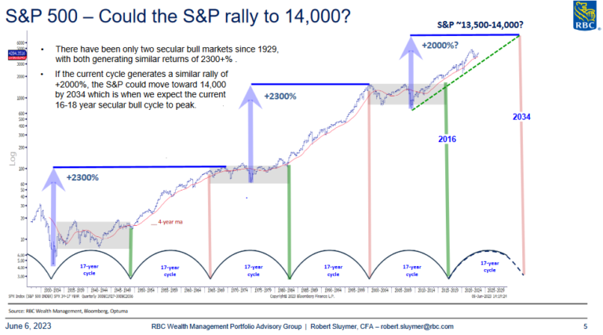
Take The Long View (Demographics) UPSIDE!

Slide 14
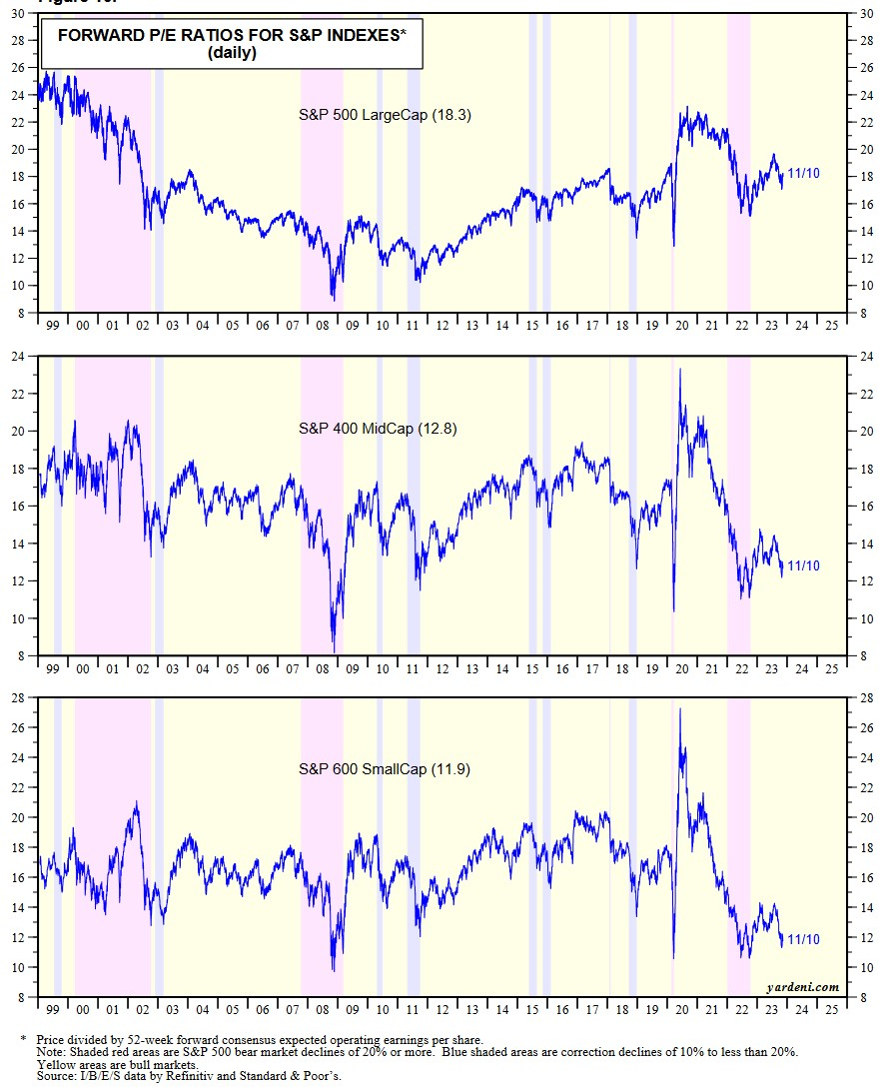
To Earn Outsized Returns: Must Bet Against Consensus and be RIGHT!
Consensus against Small Caps/Financials

Slide 15
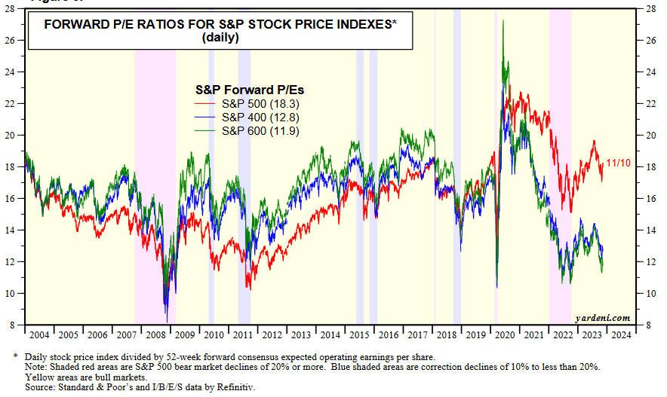
Small Cap Multiples Lowest Since GFC

Slide 16
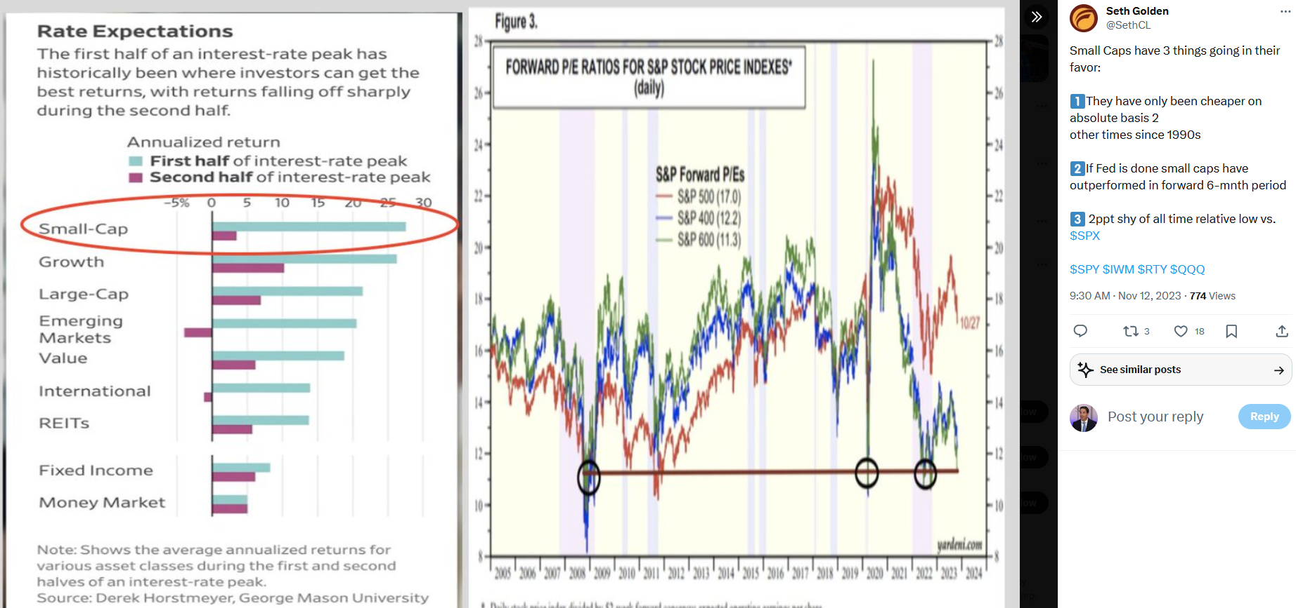
Small Caps Outperform 1st ½ of Rate Peak

Slide 17
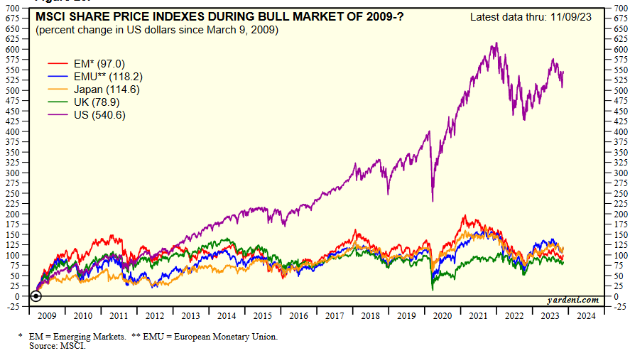
Emerging Markets/China Also Outperform 1st ½ of interest rate peak/ Catch Up Trade

Slide 18
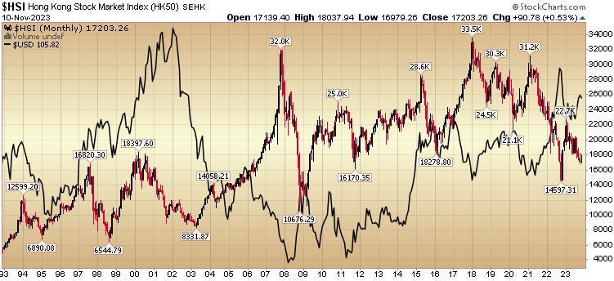
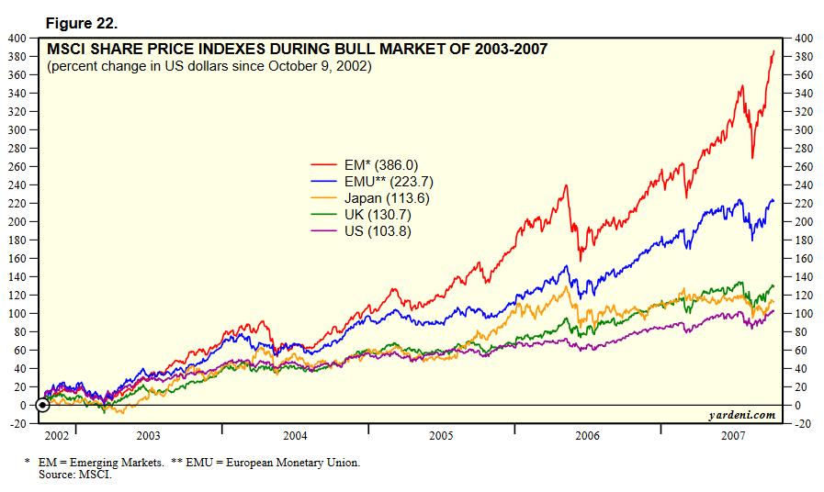
Like 2002-2007 – as USD goes down, EEM goes UP

Slide 19

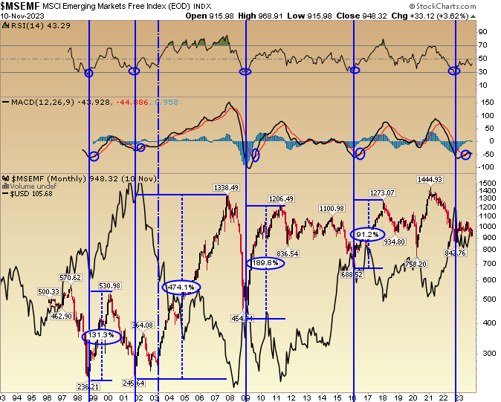

Slide 20
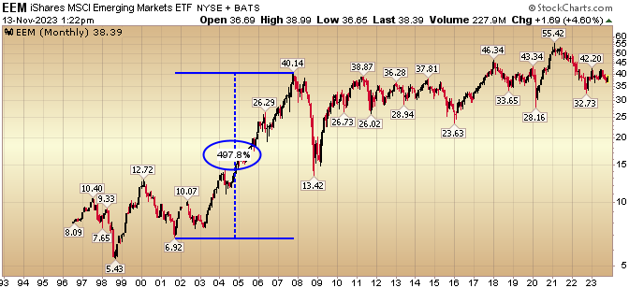
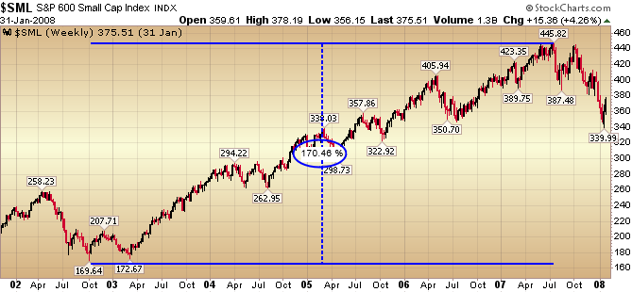
2002-2007 again?
-Emerging Markets > Developed Markets
-Small Caps > Large Caps
-Value > Growth?

Slide 21
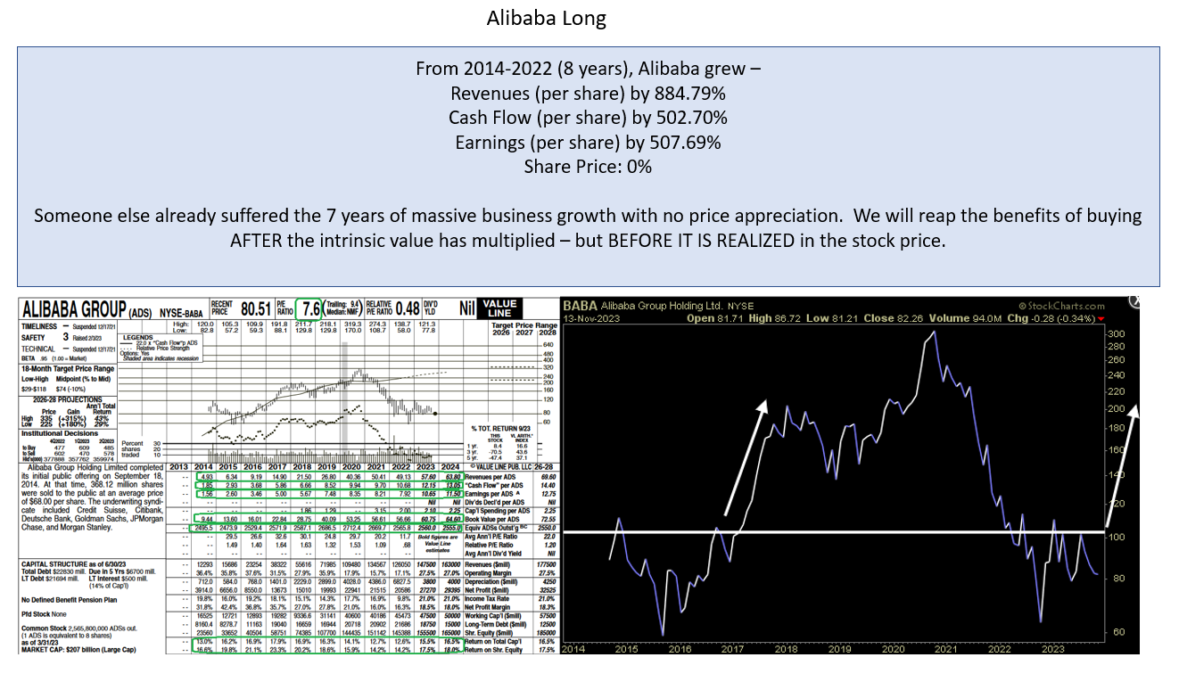
Emerging Markets (Value) Best Idea

Slide 22
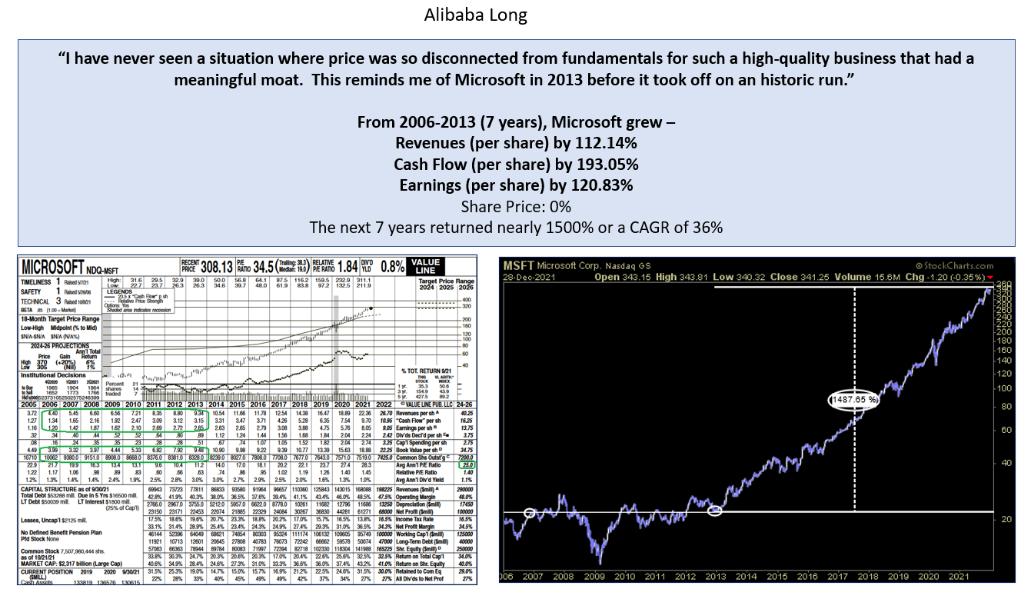

Slide 23
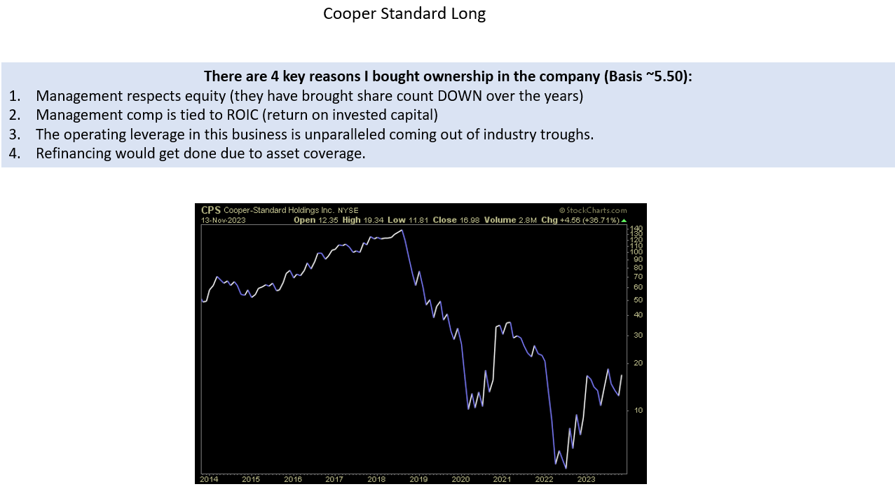
Small Cap Value Best Idea

Slide 24
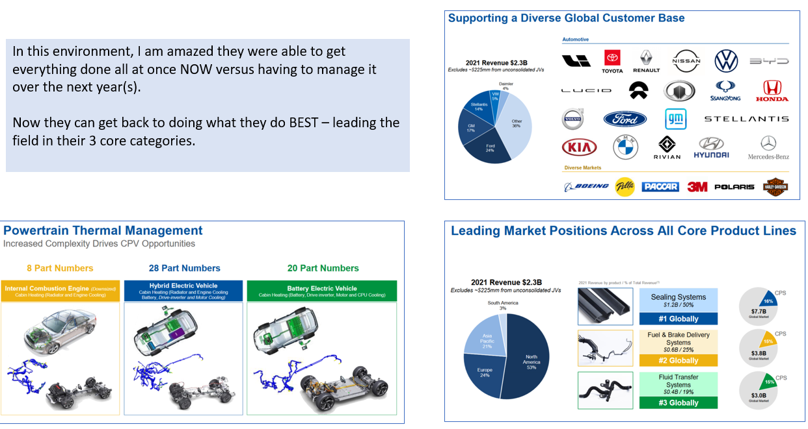
Refinancing Completed

Slide 25
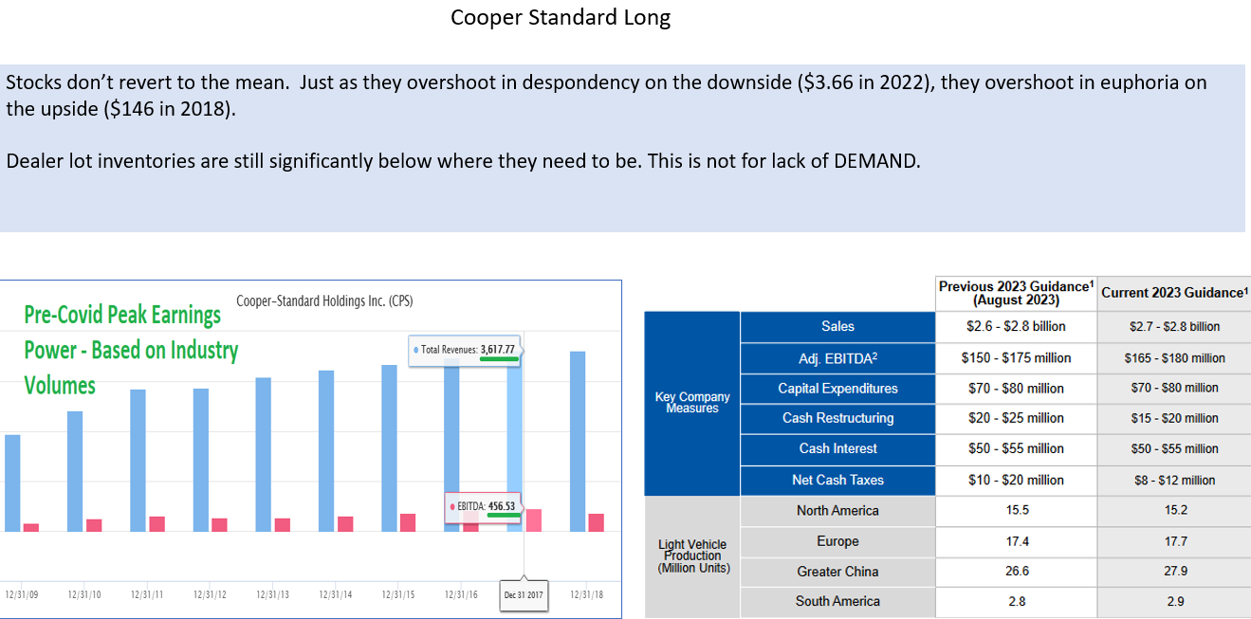

Slide 26
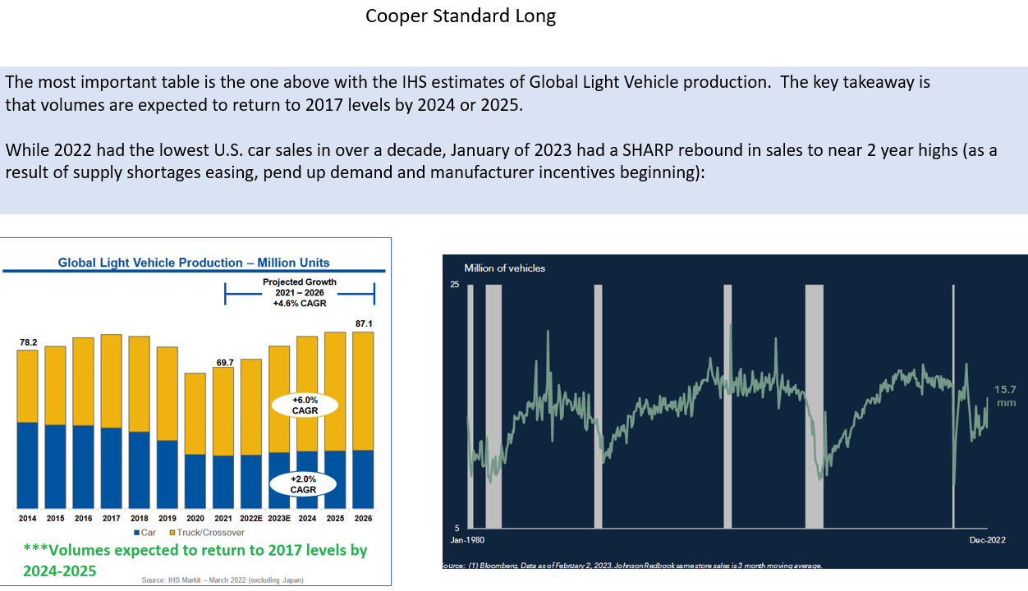

Slide 27
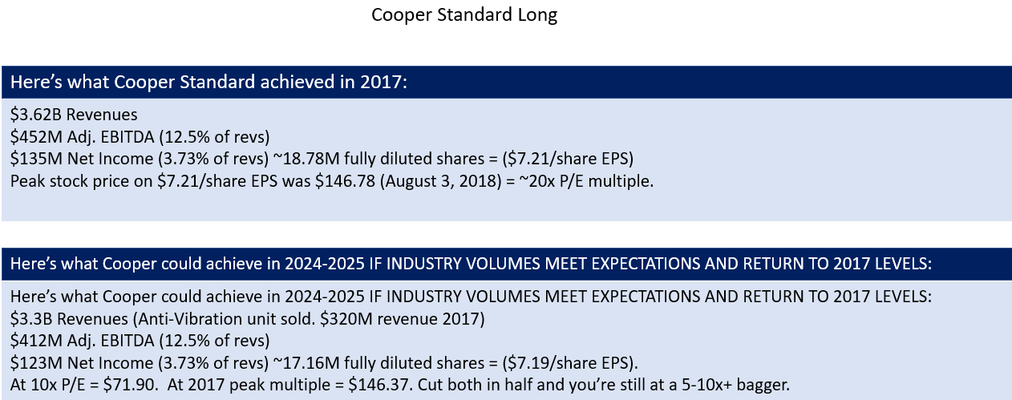

Slide 28
Thank You! *Opinion, Not Investment Advice.
Tom Hayes – Chairman & Managing Member - Great Hill Capital, LLC
“Hedge Fund Tips with Tom Hayes” Top Ranked Podcast
Twitter: @HedgeFundTips
YouTube: Search “Hedge Fund Tips”
Contact: tjh@greathillcapital.com 212-951-1478

